Slide 1
EP212 Electronics Lab 2 Analog Electronics Lecture 1 Review, and plan for this semester

Slide 2
Electronics for Physicists – the big picture
Physical
System
Amplifier
Measurement
Small
Electrical
signal
Large
Electrical
signal
Electronics Lab – 1 (EP215) last semester
Basic concepts (grounds, signal measurements)
Discrete BJT Amplifier designs (Voltage – CE, Current – Follower)
Electronics Lab – 2 (EP212) this semester
- Operational Amplifiers (opamps)
- Feedback
- Signal measurement in presence of noise
Electronics Lab – 3+4 (EP315 + EP317) next semester
- Digital measurement and control systems

Slide 3
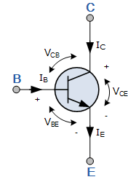
Recall BJT transistors from Electronics Lab -1
3 terminal
ACTIVE device
I_{C} = β I_{B}
I_{E} ~ I_{C}
I_{B} ~ μA ; I_{C} ~ mA
r_{e} = 25mV / I_{C}
Symbol with voltages

Slide 4
How does the transistor amplify?
i_{c}
R_{C}
V_{CC}
v_{out}
R_{C}
BJT
v_{out}
v_{in}
i_{e}
R_{E}
v_{in}
R_{E}
v_{out} = -i_{c}R_{C}
v_{in} = i_{e}R_{E}
Gain = -R_{C}/R_{E}

Slide 5
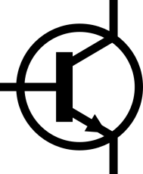
How do TWO transistors work?
V_{CC}
V_{CC}
R_{C}
R_{C}
+
−
v_{out}
v_{out}
+
−
v_{in}
v_{in}
R_{E}
R_{E}
Note: Biasing details not shown

Slide 6
Differential signals are GOOD
v_{in}⁺
t
Gain= -3
v_{out}⁺
v_{in}⁻
t
Gain= -3
v_{out}⁻
Gain is still -3, but each of
v_{in}⁺ and v_{in}⁻ need half input,
and v_{out}⁺ - v_{out}⁻ has double swing
v_{in}⁺- v_{in}⁻
t

Slide 7
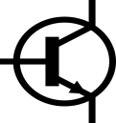
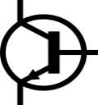
What are the constraints of differential operation?
Big advantage:
Can DC-couple v_{in} =(v₊ - v₋) at input
V_{CC}
V_{CC}
R_{C}
R_{C}
+
−
v_{out}
v_{out}
+
−
v_{in}
v_{in}
R_{E}
R_{E}
Transistors must be exactly matched
Resistors must be exactly matched
Wires must be exactly matched
Later stages (V→I) must be exactly matched

Slide 8
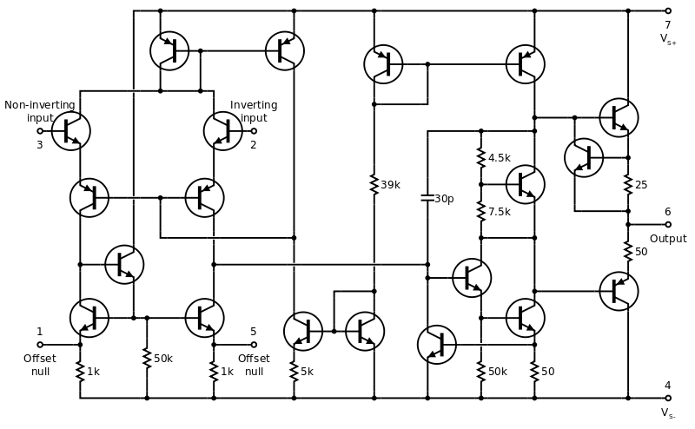
Bureau of component matching
OpAmp integrates precision matched actives+passives in one IC
Biasing etc
Input Stage
Output Stage

Slide 9
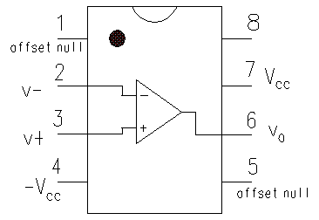
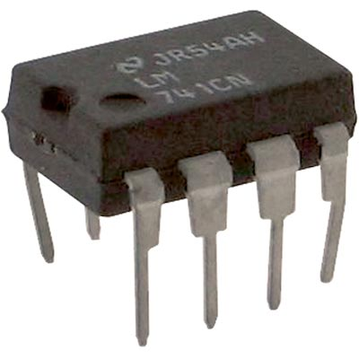
Your friend for Spring 2014 LM741 OpAmp IC
+12V
-12V
Close to zero input current (high input impedance)
Current drive output (low output impedance)
Close to infinite open loop gain
OPAMP ≡ DC coupled high gain amplifier

Slide 10
Preparation for Lab 1
Treat your friend with love and affection!
Don’t bend the IC pins when inserting into breadboard
6
5
Remember the notch
pin numbers start at the notch
You must always use dual voltage supply +V_{CC}(to pin 7) and –V_{CC}(to pin 4) |V_{CC}| < 20V
8
7
+V_{CC}
4
3
2
1
-V_{CC}
CORRECT: Each pin has a separate breadboard trace. +V_{CC} and –V_{CC} are connected along the edge traces
WRONG ! Pins 1-4 and 5-8 are shorted to each other

Slide 11
Course Reference
The OpAmp cookbook
by
Walt Jung
Available open-source online from many sites
(eg) Analog Devices “Analog Dialogue”

