Slide 1
Lecture 2 Positive Feedback Schmitt trigger
v₊
v_{o} = A(v₊ - v₋)
v₋

Slide 2
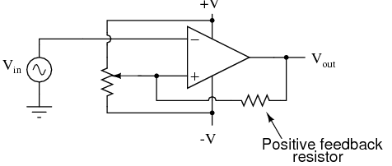
Recall simple comparator (Lab 1)
Fig 2: Simple comparator: R₁ R₂ set the threshold voltage for switching v_{out} between +V_{max} and -V_{max}
R₂
R₁
R_{f}
$$v_{+}= \frac{R_{1}}{R_{1}+R_{2}} V≡ V_{T}$$
what is v₊ ?:
$$v_{−}=v_{in}$$
For v_{in} < V_{T} → V_{out} = +V_{max}
For v_{in} > V_{T}→ V_{out} = -V_{max}
v_{o} = A(v₊ - v_{in})
+V_{max}
v_{in}
But for noisy v_{in} close to V_{T} , V_{out} swings crazily between +V_{max} & -V_{max}
-V_{max}
V_{T}

Slide 3
Review of Lab 2 POSITIVE feedback is good
Fig 3: Positive feedback through R_{f} stabilizes the circuit response
R₂
R₁
R_{f}
v₊ = f(v_{out} R₁ R₂ R_{f}) v_{out} has two values: +V_{max} , -V_{max}
Apply superposition: V_{T} already set by R₁,R₂. R_{f} sets +δv₊ and -δv₊
$${+δv}_{+}=\frac{R_{1}||R_{2}}{R_{1}||R_{2}+R_{f}}{(+V}_{max})$$
$${−δv}_{+}=\frac{R_{1}||R_{2}}{R_{1}||R_{2}+R_{f}}{(−V}_{max})$$
V_{TU}
V_{TL}
0
R₂
R₂
-V_{max}
+V_{max}
R_{f}
R_{f}
R₁
R₁
0
0
Set independent sources to zero V,v_{in}→0

Slide 4
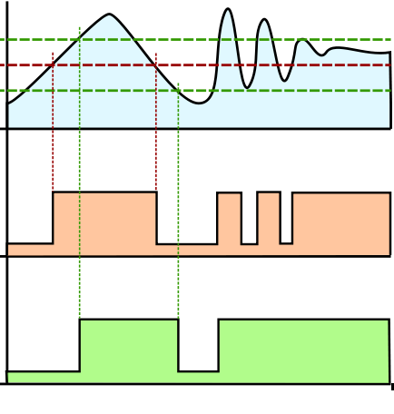
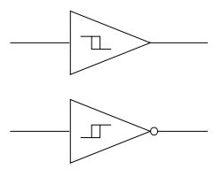
Threshold splits in two
v_{o} = A(v₊ - v₋)
v_{in}
v_{o}
v_{o}
V_{T}
V_{TU}
v_{in}
v_{in}
V_{TL}
v_{in}
v_{o}
V_{TU}
V_{T}
V_{TL}
inverting
v_{in}
v_{o} compare
Comparator
Schmitt Trigger
v_{o} Schmitt
V_{TL}
V_{TU}
Inverting Schmitt Trigger

Slide 5
Summary
In a figurative sense…
Schmitt trigger (positive feedback)
Simple comparator
V_{T}
V_{TL}
V_{TU}
v_{in}
v_{in}

