Slide 1
Lecture 4 Analysis of Negative Feedback
Reference:
1. The mathematics glossed over in this presentation can be found in the online textbook “Opamps for everyone” by Texas Instruments:
http://www.ti.com/lit/ml/sloa077/sloa077.pdf http://www.ti.com/lit/an/sloa049b/sloa049b.pdf
2. Other standard textbooks on electronics like “Introduction to Analog and Digital Electronics” by Agarwal and Lang (several copies in IIT-B central library)

Slide 2
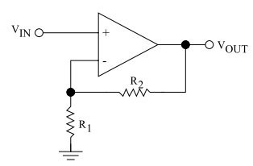
R₂/R₁ important – what factors to consider when choosing R_{i} ?
R₂ small → v_{o} needs to source large current: subtracts from the current available to load.
R₂ large → parasitic capacitances in combination with large R
introduce non-linear elements into the loop
What is large R?
What is small R?
As a thumb rule, O(10kΩ) is OK. O(1Ω) is small. O(1MΩ) is large.

Slide 3
Loop gain changes with frequency
10
1
0◦
Gain G →
BODE plot
0.1
Phase difference Δφ (degrees) →
-45◦
0.01
-90◦
10²
10³
10⁴
10⁵
10⁶
10²
10³
10⁴
10⁵
10⁶
frequency (Hz)→
frequency (Hz)→
Unity gain at 10⁶ Hz
Δφ at unity gain = -115◦

Slide 4
Bode plot summarizes the feedback loop characteristics
For LM741 = 10⁶ = 20 log₁₀(10⁶) = 120 dB
A_{OL}
20 dB/decade
Gain (dB)
A_{OL}=1
log(f)
Gain Bandwidth Product (GBWP) ≡ frequency at which gain = 1 : property of the device
Units = Hz
“Useable” range as an open loop amplifier
For LM741, A_{OL} = 120 dB, GBWP ~ 10⁶ Hz
→ at 20 dB/decade OL Gain starts dropping already at 1 Hz!

Slide 5
With feedback – we increase the frequency range of operation
A_{OL}
40 dB/decade
Gain (dB)
G=10
G=1
log(f)
“Useable” frequency range of amplifier has increased by decreasing gain to G=10
employing negative feedback

Slide 6
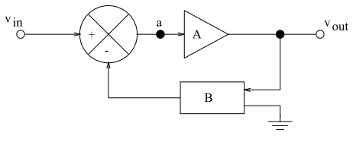
When does negative feedback (good) go bad (positive)?
Generic negative Feedback loop
v_{out} = A ∙ a = A ∙ (v_{in} – Bv_{out})
$$\frac{v_{out}}{v_{in}}=\frac{A}{1+AB}$$
B can be a reactive/active circuit → puts phase shift in the term Bv_{out}
If phase shift is 180◦ or more here, the ‘-’ sign effectively becomes ‘+’ : negative feedback will become positive! → amplifier will oscillate with no v_{in} (just noise)

Slide 7
How do you predict phase of negative feedback ?
“dominant pole”
A_{OL}
0◦
20 dB/decade
Each pole introduces -90◦ of Δφ
Gain (dB)
Phase Δφ
G=1
G=1
-90◦
log(f)
log(f)
A_{OL}
0◦
40 dB/decade
Δφ < -90◦
Gain (dB)
G=10
Phase Δφ
G=1
G=1
< -90◦
log(f)
log(f)

Slide 8
When is an opamp ‘unity gain stable’?
“dominant pole”
LM741 is Unity Gain Stable
A_{OL}
0◦
20 dB/decade
Each pole introduces -90◦ of Δφ
Gain (dB)
Phase Δφ
G=1
G=1
Δφ = -90◦
log(f)
log(f)
Dominant pole
A_{OL}
0◦
20 dB/decade
pole 2
Gain (dB)
Phase Δφ
Δφ = -90◦
40 dB/decade
phase margin:
180◦ - Δφ when G = 1
G=1
log(f)
log(f)

Slide 9
How to choose an opamp?
Design inputs:
What is the desired bandwidth? B
What is the desired gain? G
Requirements:
Choose an opamp with a GBWP of at least G∙B
b) Look at the phase response of the chosen opamp in the data sheet, especially at high frequencies near B –
Is the phase margin sufficient? Phase margin ≡(180◦ - Δφ) at G=1, should be at least 45◦ in good design.
c) Why is (b) necessary?
Answer: You can control the design, but not v_{in} !
For example stray noise can be of very high frequency, where the amplifier’s phase shift may be > 180◦
If so, your circuit will oscillate.

Slide 10
Summary
Today:
Analysis of negative feedback
Phase response, and why it matters
phase shift in feedback loop > 180◦ can turn negative feedback into positive
How to choose an opamp for a specific application

Slide 11
Reactive feedback is used in active filters
R
v_{in}
v_{out}
v_{in}
Lab 4
v_{out}
C
Passive low-pass
has G < 1
introduces phase
Active low-pass
Can set G ≥ 1
introduces phase
http://www.analog.com/library/analogdialogue/archives/43-09/active_filters.pdf

