Slide 1
Lecture 5 Opamp imperfections
Reference:
Analog Devices, Opamp basics tutorial:
http://www.analog.com/static/imported-files/tutorials/MT-038.pdf

Slide 2
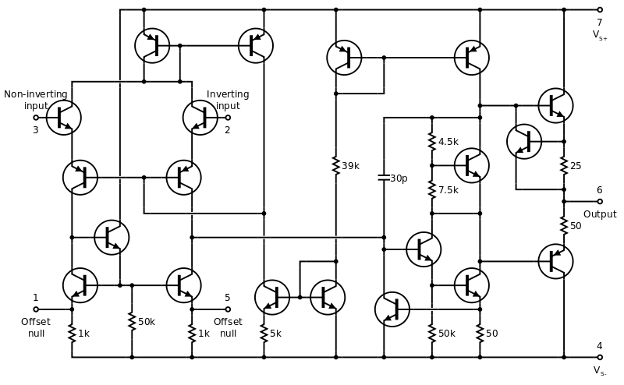
Consider opamp internals
OpAmp integrates precision matched actives+passives in one IC
Intermediate gain stages
Input Stage
Output Stage

Slide 3
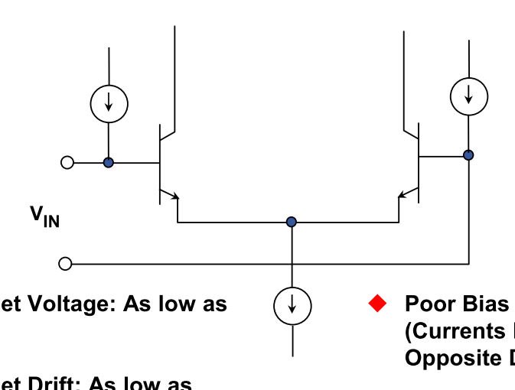
Simplified input stage
I_{E}R_{C}
I_{bias}⁺
I_{bias}⁻
I_{E}

Slide 4
Imperfection 1: V_{os}
Input offset voltage V_{os}
If I_{E} ⁺ and I_{E} – are different, voltages at the collector terminals will be different
I_{E}⁺R_{C}
I_{E}⁻R_{C}
I_{bias}⁺
I_{bias}⁻
I_{E}⁺
I_{E}
I_{E} –

Slide 5
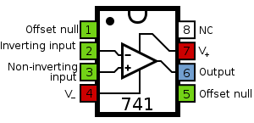
You can compensate V_{os}
Input Stage
Adjust I_{E}⁺ & I_{E}⁻

Slide 6
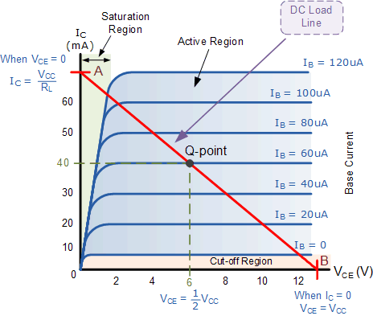
Imperfection 2: I_{bias}
I_{bias}⁺≠ I_{bias}⁻
Sets the two transistors at two different Q points
I_{bias}⁺
I_{bias}⁻

Slide 7
Cannot compensate for I_{bias}
Good news: I_{bias} is usually very very small
I_{bias}⁺
I_{bias}⁻

Slide 8
I_{bias} can be bad in a poor circuit
Bad news: I_{bias} multiplies R_{in}
I_{bias}⁺
I_{bias}⁻
Depending on R_{in},will cause a fake I_{bias}⁺R_{in} appear as v₊ even if v_{in}=0

Slide 9
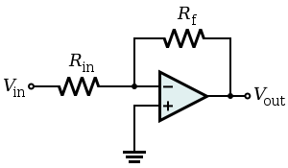
Must ‘bias compensate’ a circuit
1. At DC, with V_{in} = 0, what is the effective R ‘looking out’ from - ?
2. If there is I_{bias}⁻, what is effective V_{in} ?
3. If I_{bias}⁺ ≈ I_{bias}⁻ what must you do at the + terminal to cancel (2)

Slide 10
Must have equal DC resistance ‘looking’ out of each input terminal
1. Calculate effective R ‘looking’ out from ‘-’ terminal
2. Put in equivalent R_{eff} in the other ‘+’ terminal
3. R_{eff}*I_{bias}⁺ voltage drop cancels R_{eff}* I_{bias}⁻ at V_{in} = 0

Slide 11
Preparation for Lab 5
Read up on background of V_{os} & I_{bias}
Techniques for measuring V_{os} & I_{bias} not trivial! - measure an intrinsic property of the device without applying V_{in}

