Slide 1
Lecture 6 Review of Instrumentation Amp Impedance matching – power transfer
Reference:
“bible” of RF circuit design:
Thomas H. Lee “The design of CMOS Radio-Frequency Integrated Circuits”

Slide 2
Review of Lab 5 – Instrumentation Amplifier
Impedance looking into V₁
Impedance looking into V₂
Set V₂ to zero
Set V₁ to zero
→ v₊ = 0
→ No current into v₊
→ v₋ = v₊ = 0
→ Can ‘ignore’ the bulk of the circuit
→ V₁ sees resistance R to ground
→ V₁ sees resistance 2R to ground

Slide 3
Response of difference amplifier
Difference Response:
Common mode response
V₁ ≠ 0, V₂ = 0
V₁ = V₂ = V_{cm}
v₋ = (V_{out} – V₁)/2 v₊=0 → v₋=0 → V_{out}=V₁
v₊ = V_{cm}/2 v₋ = V_{cm}/2 (by golden rule)
v₋ = (V_{out} + V_{cm})/2 (current sum at v₋ terminal )
V₂ ≠ 0, V₁ = 0
V_{out} = 0
v₊ = V₂/2; i₊ = V₂/R; i₋ = V_{out}/R i₊ + i₋ = 0 → (V_{out} + V₂)/R = 0 →V_{out} = - V₂
Assuming ideal case 4 R’s equal
In practice:
$$V_{o}= V_{cm}\left(\frac{R_{4}}{R_{3}+R_{4}}\right)\left(1−\frac{R_{2}R_{3}}{R_{1}R_{4}}\right)$$
Superposition: V_{out} = V₁ – V₂

Slide 4
It is best to put the gain stage as close to the input signal as possible
☺ Inputs see high impedance ☹ Difference amplifier gain G no longer has A_{cm} = 0
☹ S/N is worsened by noise of unity gain buffer
V₁
1
G
V_{o}
V₂
1
☺ Inputs see high impedance ☺ Difference amplifier has A_{cm} = 0
☹ Need precise component matching to get equal G for V₁ and V₂
V₁
G
1
V_{o}
V₂
G

Slide 5
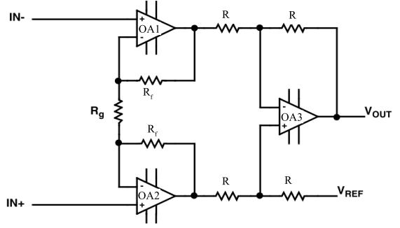
Kill two stones with one bird Reduce component count, Increase CMRR
V₁
V₁’
Differential Gain is set by R/R_{g}
(Easy to calculate by superposition)
V₂’
V₂
☺ Inputs see high impedance
Common mode: V₁ = V₂
☺ All resistors equal except R_{g}
v₋ of OA1 and OA2 are equal (two red dots)
☺ V_{o} referred to V_{ref}
→ No current flows through R_{g}
☺ A_{cm}~0 within tolerance of 6 R, R_{g}
V₁ → V₁’ and V₂ →V₂’

