Slide 1
Lecture 7 Impedance matching & power transfer
Reference:
“bible” of RF circuit design:
Thomas H. Lee “The design of CMOS Radio-Frequency Integrated Circuits”
What is “Radio Frequency” ?
Any signal with frequency content 20 kHz to ~ 100 GHz

Slide 2
Consider what happens when we introduce L and C into a circuit
Series
R
L
V
C
I
Parallel
V
I
R
L
C

Slide 3
The resonant circuit ‘picks’ out a frequency
Series
V_{in}
R
L
V_{out}
V
C
I
Can show:
For ω₀ = 1/√LC: V_{out}/V_{in} = 1 else < 1

Slide 4
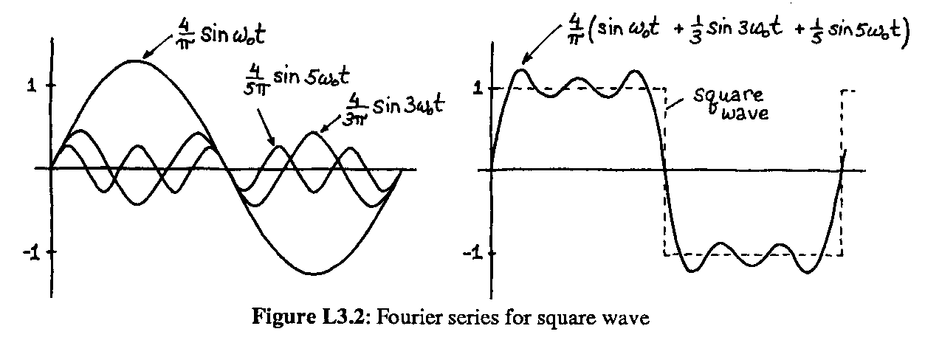
A square wave is really a sum of sines (from Fourier analysis)
When the square wave is applied as V_{in}
Frequencies near ω₀ will pass through,
others will be attenuated
R
L
V_{out}
V_{in}
C

Slide 5
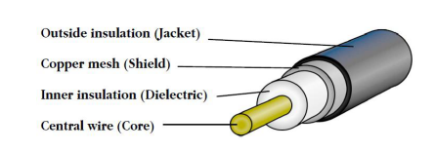
A coaxial cable is modelled as a series LC network
See http://goo.gl/l3p7s7 for a detailed analysis of a how a cable ‘works’

Slide 6
Preparation for Lab 7
Study Cables
Source Z_{S} (V_{S})
Cable Z₀ (DUT)
Cable Z₀ (DUT)
Load
Z_{L}
Device Under Test

