Slide 1
Lecture 8 Review of Co-axial cable impedance
Reference:
“bible” of RF circuit design:
Thomas H. Lee “The design of CMOS Radio-Frequency Integrated Circuits”
What is “Radio Frequency” ?
Any signal with frequency content 20 kHz to ~ 100 GHz

Slide 2
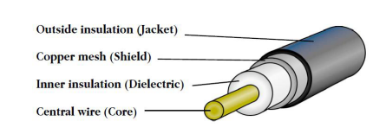
A coaxial cable is modelled as a series LC network
See http://goo.gl/l3p7s7 for a detailed analysis of a how a cable ‘works’

Slide 3
Laboratory 7 – we studied coaxial cables
Cable Z₀ (DUT)
Source Z_{S} (V_{S} I_{s})
Load Z_{L}
V_{s} I_{s} V_{R} I_{R}
Device Under Test

Slide 4
Each device must obey Ohm’s law V=I∙Z
2 terminals
4 terminals
2 terminals
Cable Z₀ (DUT)
Source Z_{S} (V_{S} I_{s})
Load Z_{L}
V_{s} I_{s} V_{R} I_{R}
Device Under Test

Slide 5
Z_{L} – two terminal device
2 terminals
Load Z_{L}
V_{s} I_{s} V_{R} I_{R}
$$V=V_{s}+V_{R}$$
$$I=I_{s}+I_{R}$$
$$Z_{L}=\frac{V_{s}+V_{R} }{I_{s}+I_{R} }$$

Slide 6
Z₀ :superposition (output terminals)
4 terminals
Cable Z₀ (DUT)
$$Z_{0}=\frac{V_{R} }{−I_{R} }$$
$$Z_{L}=\frac{V_{s}+V_{R} }{I_{s}+I_{R} }$$

Slide 7
Z₀ :superposition (input terminals)
4 terminals
Cable Z₀ (DUT)
$$Z_{0}=\frac{V_{S} }{I_{S} }$$
$$Z_{0}=\frac{V_{R} }{−I_{R} }$$
$$Z_{L}=\frac{V_{s}+V_{R} }{I_{s}+I_{R} }$$

Slide 8
Solve to get reflection co-eff Γ
$$We are looking for Γ= \frac{V_{R}}{V_{S}}= \frac{I_{R}}{{−I}_{S}}$$
$$Z_{L}=\frac{V_{s}(1+Γ)}{I_{s}(1−Γ)}$$
$$Z_{L}=Z_{0}\frac{ (1+Γ)}{ (1−Γ)}$$
$$Z_{0}=\frac{V_{S} }{I_{S} }$$
$$Γ=\frac{Z_{L}−Z_{0}}{Z_{L}+Z_{0}}$$
$$Z_{0}=\frac{V_{R} }{−I_{R} }$$
$$Z_{L}=\frac{V_{s}+V_{R} }{I_{s}+I_{R} }$$

Slide 9
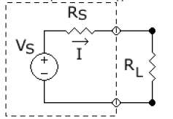
DC v/s AC power transfer
AC source
Cable Z₀ (DUT)
Source Z_{S} (V_{S} I_{s})
Load Z_{L}
V_{s} I_{s} V_{R} I_{R}
Compare – DC power transfer
$$\frac{P_{L}}{P_{s}}= \frac{1}{\left(1+\frac{R_{S}}{R_{L}}\right)}= \frac{1}{2} (max)$$
source
Fig 1

Slide 10
Is AC power transfer better than 0.5?
AC source
Source Z_{S} (V_{S} I_{s})
v →V
i → i
V→V
i → i
Load Z_{L}
V_{s} I_{s} V_{R} I_{R}
Cable Z₀
Actually – NO
Source Z_{S} sees load (Z_{L} “through” the cable Z₀ ) = Z_{eff}
Max power transfer when Z_{S} = Z_{eff}
But power lost in cable Z_{o} = I²R → can be significant for ~ km’s of cable
Transformers are used to step UP V and step down i at source
(Substation) transformers are used at load to step down V and step UP i

Slide 11
Signal transfer requires more thought
AC source
co-ordinate z
Source Z_{S} (V_{S} I_{s})
Load Z_{L}
V_{s} I_{s} V_{R} I_{R}
Cable Z₀
Signal being transmitted in the cable has the general form:
Voltage: e^{-iβz} + Γe^{+i βz} for a harmonic signal. (ignoring the e^{iωt} part)
Forward wave
Reflected wave
$$β= \frac{1}{\sqrt{LC}}= \frac{1}{\sqrt{(R+jωL)(G+jωC}} is the propagation speed$$
Lossless
Lossy (cf. Slide 3) β ~ 1/ω
High frequency
signals travel slower

Slide 12
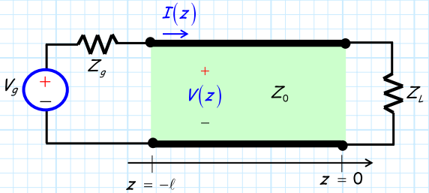
For a source signal (V_{g}, I) what is the final signal (V,I) delivered to the load?
Lossless:
V₀, I₀ same across Z₀
Phase changes
V₀
V₀
Must satisfy boundary conditions at both z=0 and z = -l
At z=0, we have already satisfied : V(z) = V₀⁽e^{-iβz} + Γe^{+i βz})
At z=-l, we must have : V_{in} = V₀⁽e^{+iβl} + Γe^{-i βl})
What is V₀?

Slide 13
Signal transmission depends on all the circuit elements (in a bad way!)
V₀
V₀
Use KVL to express V₀ in terms of V_{g} , Z_{g} , I
V_{g} = V(z=-l) + Z_{g}I(z=-l)
V_{g} = V₀⁽e^{+iβl} + Γe^{-i βl}) + Z_{g} V₀/Z₀ (e^{+iβl} – Γe^{-i βl} )

Slide 14
Signal transmission depends on l (complex) Z_{L}, Z₀
V₀
V₀
Solve to get:
$$V_{0}=V_{g}e^{−jβl}\frac{Z_{0}}{Z_{0}\left(1+Γ\right)+ Z_{g}\left(1−Γ\right)}$$
f(Z_{L},Z₀)!
V_{g} = V₀⁽e^{+iβl} + Γe^{-i βl}) + Z_{g} V₀/Z₀ (e^{+iβl} – Γe^{-i βl} )

Slide 15
Signal transmission depends on l & (complex) Z_{L}, Z₀
V₀
V₀
$$V_{0}=V_{g}e^{−jβl}\frac{Z_{0}}{Z_{0}\left(1+Γ\right)+ Z_{g}\left(1−Γ\right)}$$
Even for an ideal lossless cable: Voltage (and hence current) delivered to load depends on l, Z_{L}, Z₀

