Slide 1
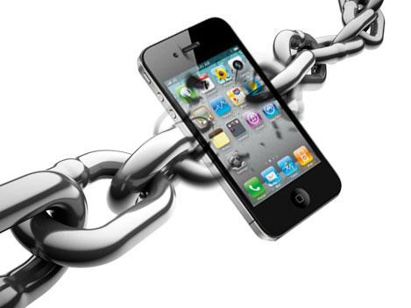
EP215 Electronics Lab 1

Slide 2
Grading Scheme
70% labs + 30% endsem
You will work in groups. Each person will be graded individually. You will appear for the endsem exam individually.
Each group will get a lab kit containing components necessary for all labs. Keep your lab kit safe.
You will receive a lab assignment on each Tuesday at 2pm. It must be completed in 3 hrs.
There is no lab manual. You develop a procedure to solve the problem based on what you know about electronics.
There is no journal either. Your assignments are set up in parts. All parts are graded during the lab session

Slide 3
Why are you in
Electronics Lab ?
Why do you need electronics techniques ?
What you can expect to learn by the end of EP215.

Slide 4
Why do we need Electronics ?
Physical Chemical
System
Measurement
Small
Electrical
signal
Amplifier
Large
Electrical
signal
Examples:
Resistance of a carbon nanotube
Signal deposited by a proton in detector at LHC
Fluoroscence in chemical sample
View an AFM image of a protein folding in real time.
Where is the power?

Slide 5
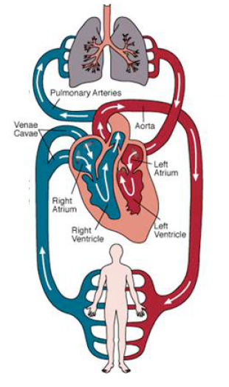
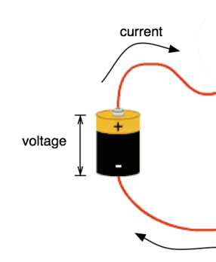
Voltage or Potential – Current – Power
What do these terms mean?
Electrical
signal
Device
X
current
potential
Heart pumps→Blood flows

Slide 6
What does Potential mean ?
Literally – the potential to do something
Eg: potential of JEE entrant to become a good engineer
potential of AIR 10 to do better than AIR 1000
In our case:
potential to supply current on demand
With reference to what ?

Slide 7
Where does the current go ?
12V
i
Physical Chemical
System
Electrical
signal
current
i
GND
Most of the current is used by
the system: only a small amount sampled for measurement

Slide 8
What does the Amplifer do ?
12V
i
12V
i
Physical Chemical
System
Large
Electrical
signal
δ current
Amplifier
i
i
GND
GND
Amplifier “samples” small amount
of current and makes it big

Slide 9
How do you make the measurement ?
12V
i
12V
12V
i
Physical Chemical
System
i
Measurement
δ current
Amplifier
Δ current
i
i
i
GND
GND
GND
The final measurement device –
an analog to digital converter
(Digital Multimeter [DMM] or Oscilloscope [DSO])

Slide 10
Problem of GND !
12V
i
12V
12V
i
Physical Chemical
System
i
Measurement
δ current
Amplifier
Δ current
i
i
i
GND
GND
GND
GND potentials need not be the same !
Matters a lot when δ current is small

Slide 11
Ideal solution – Use differential supplies
source
+V_{ref}
+V_{ref}
amplifier
measure
+V_{ref}
i
i
Physical Chemical
System
i
Measurement
δ current
Amplifier
Δ current
i
i
-V_{ref}
measure
i
-V_{ref}
amplifier
source
-V_{ref}
Make sure to use differential supply
when δ current drawn from the system is small

Slide 12
The Amplifier is the most interesting part
+V_{ref}
i
δ current
Amplifier
Δ current
i
-V_{ref}
Assumption: 12th pass and JEE pass already know about R, C, L passive)
We will focus on active devices that transform
δ to Δ , where δ and Δ can be either/both
current and voltage.

Slide 13
Preparations for the lab
Revise general electronics background:
http://www.allaboutcircuits.com/
A community built website on all things related to
electronics (like Wikipedia).
Keep me informed of mismatches between your lab work and theory preparation

Slide 14
Preparations for the lab
Lecture Schedule:
Work out an acceptable 1-hour slot for a weekly lecture:
Suggestions:
Wednesday 3pm to 4pm
or
Friday 3pm to 4pm

