Slide 1
EP215 Electronics Lab 1
Lecture 3
Review of Lab 2
Simplest Active device: DIODE

Slide 2
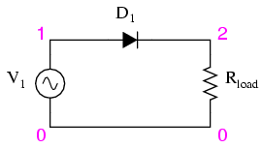
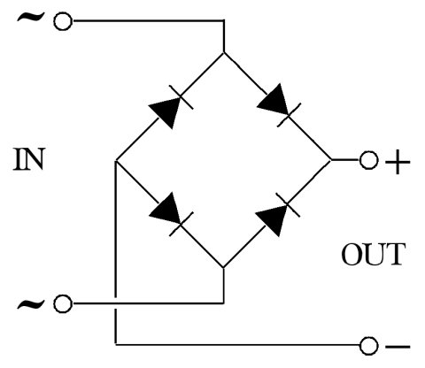
Review of Lab 2
1. One Diode (voltage) clamp
V_{in}
V_{out}
D₁
Fig 1
0V
V_{in}
V_{out}
2. Two Diode (voltage) limiter
D₂
D₁
Fig 2
3. One Diode half-wave rectifier
Fig 3
1
D₂
Fig 4
D₁
3
4. Four diode full-wave rectifier
V_{in}
OUT
V_{out}
D₄
D₃
2
4

Slide 3
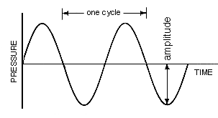
What happens in a diode clamp?
V_{in}
V_{out}
D₁
V_{in}
Fig 1
0V
If V_{in} < 0.7V, V_{out} = V_{in}
If V_{in} > 0.7V, V_{out} = 0.7V
0.7V
V_{out}
Follow up questions:
1. This circuit only clamps the positive part of V_{in} What modification would cause it to clamp the negative part of V_{in}?
2. What modification would make it clamp both positive and negative ?

Slide 4
What happens in a diode clamp?
V_{in}
V_{out}
D₁
V_{in}
Fig 1
0V
If V_{in} > 0.7V, V_{out} = V_{in}
If V_{in} < 0.7V, V_{out} = 0.7V
V_{out}
0.7V
What modification would cause it to clamp the negative part of V_{in}?

Slide 5
Diode Limiter
http://www.falstad.com/circuit/e-diodelimit.html
Half wave Rectifier
http://www.falstad.com/circuit/e-rectify.html

Slide 6
Full wave rectifier
http://www.falstad.com/circuit/e-fullrect.html
DSO-1
1
D₂
D₁
DSO-2
3
V_{in}
OUT
V_{out}
D₄
D₃
2
4

Slide 7
Full wave rectifier
with measurements of V_{in} V_{out}
http://www.falstad.com/circuit/e-fullrect.html
DSO-1
1
D₂
D₁
DSO-2
3
V_{in}
OUT
V_{out}
D₃
2
4

Slide 8
Full wave rectifier
Looks like a negative clamp from V_{in}
http://www.falstad.com/circuit/e-fullrect.html
DSO-1
1
D₂
D₁
3
V_{in}
OUT
V_{out}
D₃
2
4
V_{in}
0.7V

Slide 9
Full wave rectifier
Looks like a half-wave rectifier from V_{out}
http://www.falstad.com/circuit/e-fullrect.html
1
D₂
D₁
DSO-2
3
V_{in}
OUT
V_{out}
D₃
2
4
V_{out}
Note: D₁ and D₃ function as positive clamps (like Slide 4)
– but are irrelevant, because the half-wave rectification makes sure that V_{out} is always positive.

Slide 10
Full wave rectifier
Looks like a half-wave rectifier from V_{out}
http://www.falstad.com/circuit/e-fullrect.html
1
D₂
D₁
DSO-2
3
V_{in}
OUT
V_{out}
D₃
2
4
V_{out}
Notice the green dots which represent 0V

Slide 11
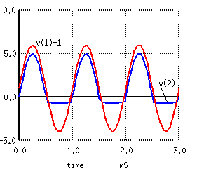
Prep for Lab 3
We have used ‘working’ definitions of Diode operation:
Cathode to Anode voltage > 0.7V → ‘ON’
Cathode to Anode voltage < 0.7V → ‘OFF’
This is not good enough for detailed circuit building & analysis
V_{out}
0.7V

Slide 12
I-V characteristics of two terminal devices
As the voltage across a diode increases from 0.65V to 0.75V it changes smoothly from: (V)
A state of not conducting current (I)
To a state of conducting current
We will learn how to determine the I-V characteristics of
any two terminal device without using graph paper!

Slide 13
Useful reference for this course
“Foundations of Analog and Digital Electronics”
by Anant Agarwal and Jeffrey Lang
http://www.allaboutcircuits.com

