Slide 1
EP215 Electronics Lab 1
Lecture 4
Review of Lab 3: I-V characteristics
and stray effects

Slide 2
What is special about
the differential input test setup?
I
B_{X}
Function
Generator:
Sine wave
voltage
Use differential signal (rd/wht) on red cable from back of unit.
+
Part to
be tested
X
V_{X}
+
10MΩ
To DSO Channel 1abelled '1'
I
-
-
A
0
-
R_{ref} = 1000 Ω
10MΩ
To DSO Channel labelled '2'
V_{Rref}
+
B_{R}
DSO
I_{X} = V_{Rref}
R_{ref}
Fig 1: Setup for Assignment 3
Input signal at these points
Must not refer to GND potential

Slide 3
What is special about
the differential input test setup?
I
B_{X}
Function
Generator:
Sine wave
voltage
Use differential signal (rd/wht) on red cable from back of unit.
+
Part to
be tested
X
+
10MΩ
To DSO Channel 1abelled '1'
I
-
-
A
0
-
R_{ref} = 1000 Ω
10MΩ
To DSO Channel labelled '2'
+
B_{R}
DSO
Fig 1: Setup for Assignment 3
If one leg of the signal is GND,
No current across R_{ref} !

Slide 4
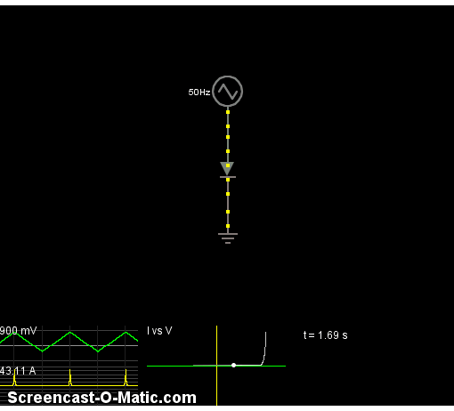
Lab 3: I-V characteristics
http://www.falstad.com/circuit/e-diodecurve.html

Slide 5
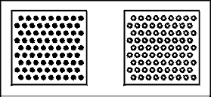
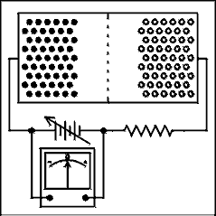
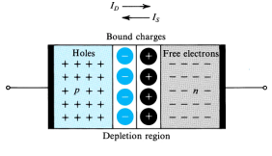
Diode I-V at low frequency
PN junction
Bound charge between
metal electrodes
→ Capacitor
Reverse Bias
Forward Bias

Slide 6
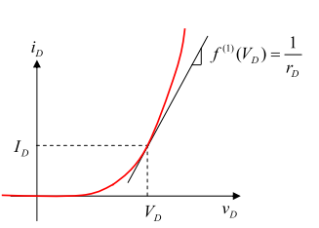
Diode I-V at low frequency
n=2;
V_{T} = 25mV thermal voltage
In forward bias
Diode is modeled as:
r_{d}

Slide 7
Diode I-V at high frequency
Effective capacitance of the depletion layer becomes important at high frequency
(C_{j} + C_{d})
Note: in dimension:
time * current = charge
So C = Q/V makes sense
r_{d}

Slide 8
Diode I-V at high frequency
Different capacitance in Forward and Reverse bias:
I
1 kHz
V
(C_{j} + C_{d})
10 kHz
I
r_{d}
Different transit times of charge across the depletion barrier
→ r_{d} and (C_{j}+C_{d}) determine a time constant
→ As frequency of V_{in} changes, the time constant causes delayed response.
V

Slide 9
Resistor I-V characteristics
I
B_{X}
Function
Generator:
Sine wave
voltage
Use differential signal (rd/wht) on red cable from back of unit.
+
R_{unknown}
To DSO Channel 1abelled '1'
+
I
-
-
A
-
R_{ref} = 1000 Ω
To DSO Channel labelled '2'
+
B_{R}
DSO
Resistor as part X whose value is to be determined from slope of I/V assuming V=I*R
This schematic works fine at low frequency when the resistor behaves like an ‘ideal’ resistor.

Slide 10
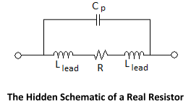
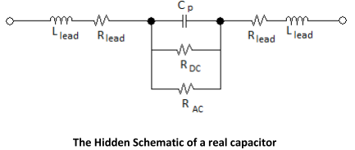
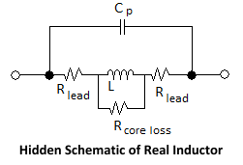
In reality, there is a
‘hidden’ schematic behind every
device
Note: these are parasitic, frequency dependent
effective components of very small value.
So there is no infinite loop here!
See accompanying notes on ‘The Hidden Schematic’

Slide 11
At high frequency, our test setup changes
Function
Generator:
Sine wave
voltage
Use differential signal (rd/wht) on red cable from back of unit.
+
R_{unknown}
To DSO Channel 1abelled '1'
+
-
-
-
R_{ref} = 1k Ω
To DSO Channel labelled '2'
+
DSO
All these parasitic component values are different

Slide 12
What is the effect of parasitic components on I-V characteristic?
What do V and I look like in the time domain?
V_{R}
V_{L}
V_{C}
t
t
t
I_{R}
I_{L}
I_{C}
t
t
t
L: V_{L}=L*dI_{L} /dt
Small L is in series,
so I_{L}=I_{R} linear
C: V_{L}=C * ∫ I dt
C in parallel, gets very small I from I_{R}
Resistor: V_{R}=R*I_{R}

Slide 13
What is the effect of parasitic components on I-V characteristic?
In our cool X-Y display format to get I-V characteristics:
I
V_{C}
1/R
t
V
I_{C}
t
C: V_{L}=C * ∫ I dt
C in parallel, gets very small I from I_{R}
Resistor: V_{R}=R*I_{R}

Slide 14
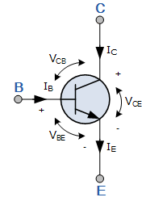
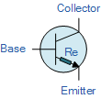
What’s next?
Transistor
Bipolar junction transistor
Graduating from a two terminal device to a three terminal device
Base-Emitter junction diode highlighted as ‘r_{e}’
NPN transistor

