Slide 1




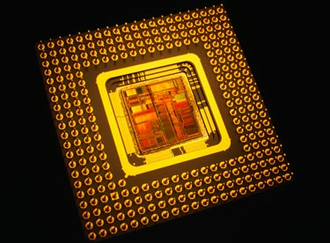



EP315
Microprocessors

Slide 2
EP315
Microprocessors for Physicists
Control
Readout
Physics Experiment

Slide 3
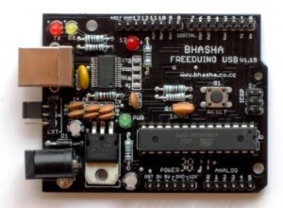
EP315
Microprocessors for Physicists
Arduino

Slide 4
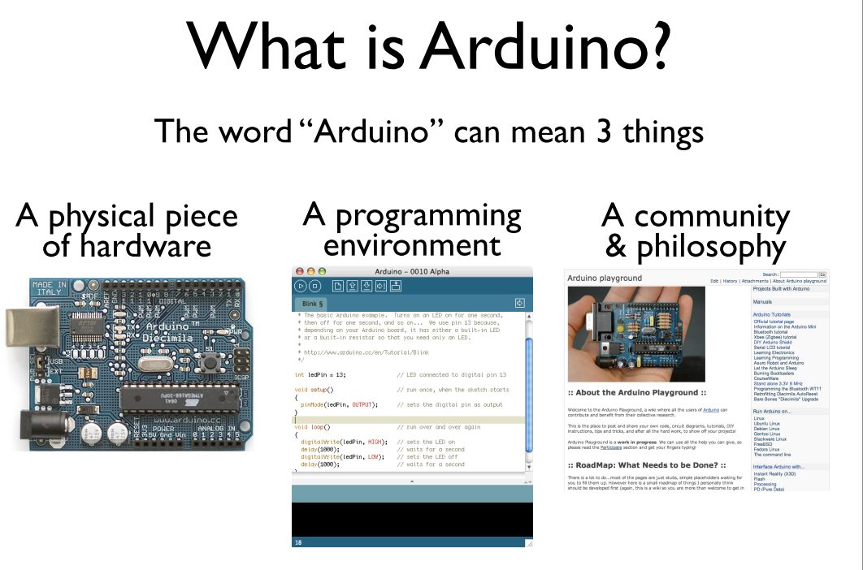
http://www.arduino.cc

Slide 5
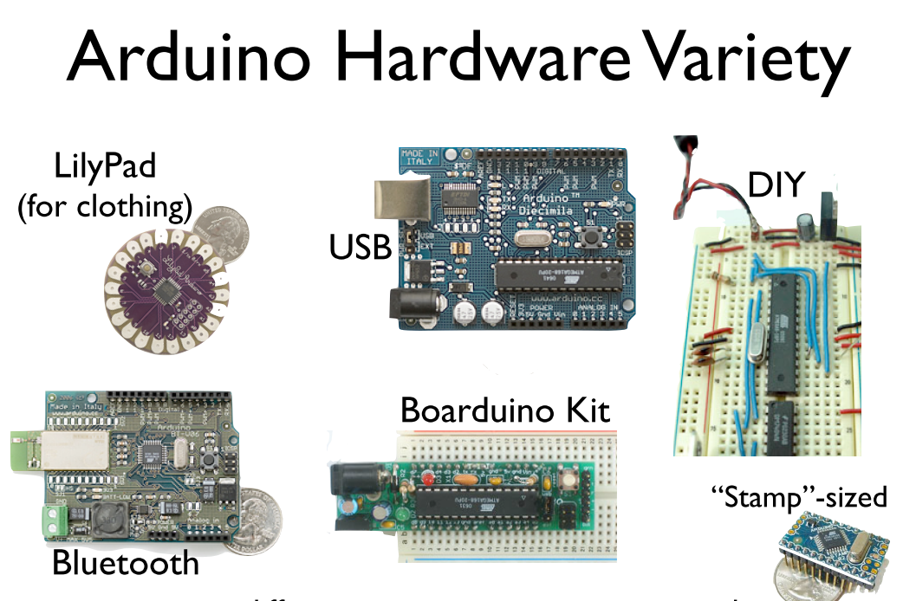

Slide 6
The Heart of the Arduino hardware

Slide 7
What is the ATMEGA168?
A microcontroller → microprocessor that works on
a specific task
16 kB of Flash RAM
1 kB of RAM
16 MHz clock speed (Typical clock speeds in PC’s ~ GHz)
Inputs and Outputs → direct connection to external hardware
  13 digital Input/Output pins
  5 Analog Input pins
  6 Analog Output pins (kind of)
Stand-alone unit : program from your PC, then disconnect
and it runs on it’s own (with DC power)
Smartphones

Slide 8
What do these terms mean?
“Sketch” : program written for the Arduino. You write the
code in C. Then compile and upload to the board
over USB
“Pin” : An input or output pin connected to something,
e.g. LED, pushbutton, servo-motor etc
Note: all digital pins are dual purpose – you define in your sketch
whether you want to use it as input or output
“Digital”: Value is either HIGH or LOW, corresponding voltage
appearing at the pin is 5V or 0V
“Analog”: Value ranges from 0 to 1024 – corresponds
(by default) to voltage measured at pin from 0 to 5V

Slide 9
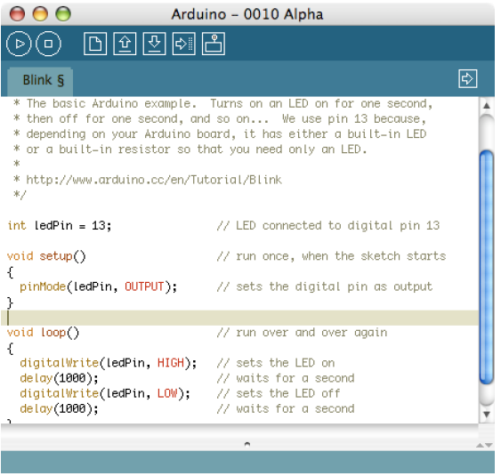
Arduino Software
(Integrated Development Environment – IDE)
Setup on the Elec. Lab PC’s
You can easily download and
set it up on your own laptop/PC
using website http://arduino.cc
It let’s you :
Write/Edit/Compile Sketches
Download to Arduino board

Slide 10
What is an Arduino “Sketch”
Basic structure of an Arduino sketch:
[… Area to declare global variables …]
void setup()
{
… area to setup hardware, eg. Set pin modes to inp/out etc
}
void loop()
{
send_pulse_to_pin(13, 1);
… main program that will run continuously …
}
send_pulse_to_pin(pin_X,duration_d)
{
digitalWrite(pin_X, HIGH); // set pin_X HIGH
delay(duration_d); // wait for duration_d millisec
digitalWrite(pin_X, LOW); // set pin_X back to LOW
}
Necessary
components of
valid sketch

Slide 11
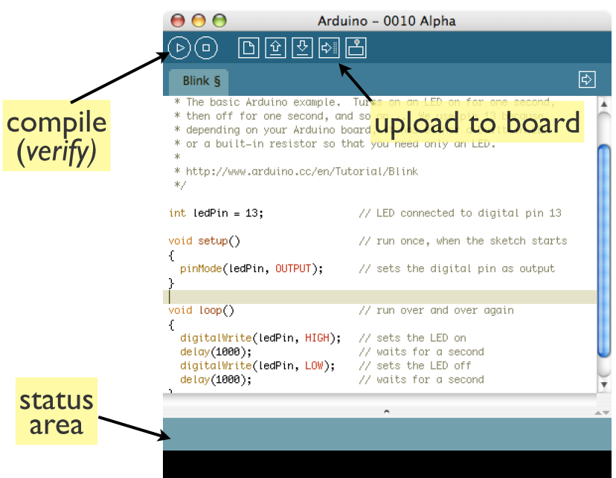
Getting started with the Arduino

Slide 12
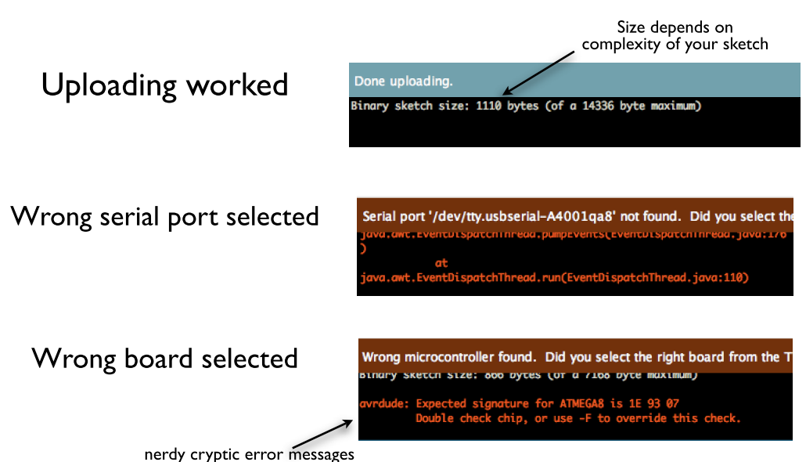
Typical Status messages
This is usually not a good sign – check board selection, try again,
else you have likely fried the ATMEGA168 → trip to Lamington Rd

Slide 13
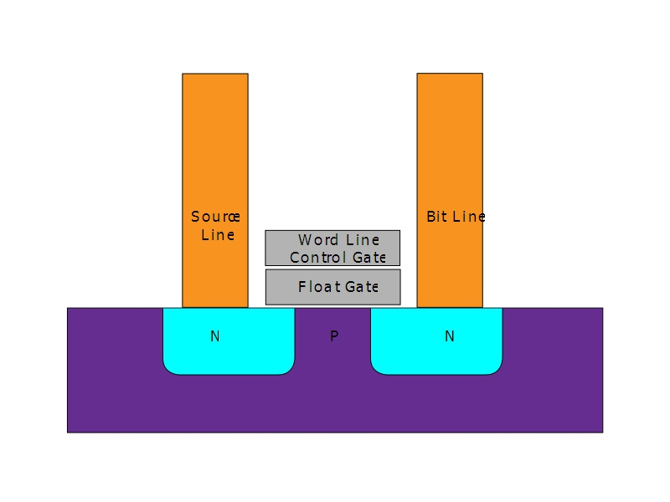
What does “uploading” program to Arduino mean?
→Program is loaded into the FlashRAM – stored
permanently (until you upload a new program).
→Everytime Arduino is powered up, it starts
running the program.
→There is only one program in the FlashRAM.
How does this work ?
Charge is stored
here by control gate.
Permanently keeps
The transistor
ON or OFF
Cell of Flash RAM

Slide 14
EP315 Course structure
Approx 5 lab sessions 30%
Project* 45%
End-semester exam 25%
*See http://home.iitb.ac.in/~pradeepsarin/teaching
for past years’ projects

