Slide 1
Lecture 3
Finite State Machines
Definition:
A system which has a finite number of states that can be encoded in binary form
The system remembers what state it is in – called the Present State (PS)
Transitions between the states are governed by (usually) deterministic rules –
These rules operate upon the input and the PS and cause the FSM to transition to the Next State (NS). At the following time step, the NS becomes the PS.

Slide 2
The ATmega168 microcontroller,
… or any other microprocessor
functions as a (complex)
Finite State Machine
Details are different depending on
the processor architecture:
Number of states
Sequence of state transitions
Delay between transitions (CPU clock)

Slide 3
ATMega168
Micro-controller
(mostly)
complete diag.

Slide 5
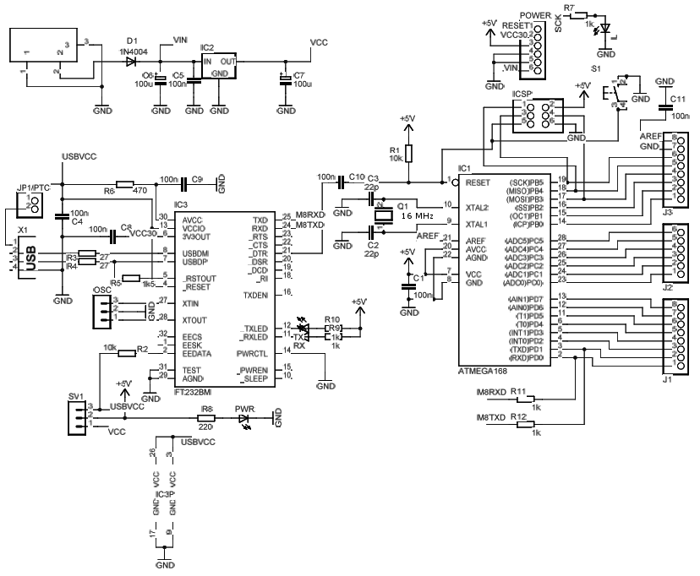
Arduino Board Design

Slide 6
There are other,
Simpler
Finite State Machines
we can study in more detail

Slide 7
Example: Odd Parity Checker
Input: String of 0101001011010….
Objective:
Assert output 1 whenever input bit stream has odd number of 1's
Three things matter:
Present State i.e. system needs to ‘remember’ its state
Input
Next State
Output is indicated by
Using binary logic, need memory elements:
2 states – 1 bit binary
3 states – 2 bit binary
4 states – 2 bit binary …
State
Diagram

Slide 8
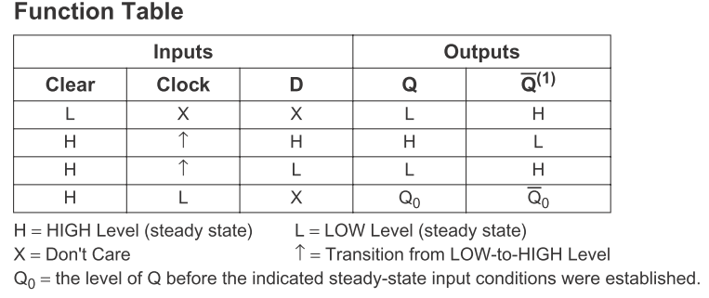
Basic 1-bit memory element:
D register
D
Q
D
CLEAR
CLOCK

Slide 9
Implementation 1 of parity checker:
Next State is calculated based on Input and Present State
Output is equal to the present state of the system
Present State
Input
Next State
Output
Even
0
Even
0
Even
1
Odd
0
Odd
0
Odd
1
Odd
1
Even
1
Symbolic State Transition Table
State
Diagram
Encoded State Transition Table
Use the FSM State Table to deduce the Boolean Logic function of
Next State= f (Present State, Input)

Slide 10
Combinational Logic: NS = PS XOR Input
Implementation 1: Output = PS
NS
Input
D
Q
CLK
PS=Output
R
Q
Reset

Slide 11
Implementation 2 of parity checker :
Next State is calculated based on Input and Present State
Output is equal to the next state of the system
Present State
Input
Next State
Output
Even
0
Even
0
Even
1
Odd
1
Odd
0
Odd
1
Odd
1
Even
0
Symbolic State Transition Table
Present State
Input
Next State
Output
0
0
0
0
0
1
1
1
1
0
1
1
State
Diagram
1
1
0
0
Encoded State Transition Table
Use the FSM State Table to deduce the Boolean Logic function of
Next State= f (Present State, Input)
(Mealy FSM)

Slide 12
Combinational Logic: NS = PS XOR Input
Implementation 1: Output = PS
Implementation 2: Output = (PS xor I) = NS
NS
NS=Output
Input
D
Q
Input
CLK
PS=Output
D
Q
PS
Q
CLK
R
R
Q
Reset
Reset
Timing Behavior: Input 1 0 0 1 1 0 1 0 1 1 1 0

Slide 13
State Register
1. Moore Machine
Outputs are function
of the present state
Outputs change
synchronously with
state changes
X
i
Combinational
Present State
Z_{k}
Inputs
Logic for
Outputs
Next State
Clock
state
Remember: CLK must enter the Memory element
used to store states of the system!
feedback
2. Mealy Machine
Outputs depend on
state AND inputs
Input change causes
an immediate output
change
Asynchronous outputs
X
Z
k
i
Combinational
Outputs
Inputs
Logic for
Outputs and
Next State
Present State
State
State Register
Clock
Feedback

Slide 14
Moore-Mealy difference

Slide 15
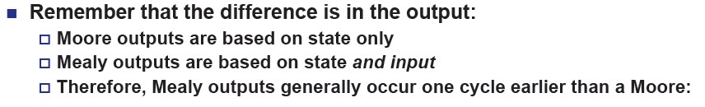

Moore-Mealy trade-offs
But… Mealy FSM responds immediately (asynchronously) to Input –
Susceptible to Input Glitches in a complex FSM.
CLK (which synchronizes change of state) may get delayed in propagating change
of state through the memory registers.

